Slide 1
Modularizing JavaScript
Suresh

Slide 2
Agenda
Modules in JavaScript
Importance of Modularization
Types of Java Script modules
Webpack
SystemJS and JSPM
Code Samples and Examples
Q & A

Slide 3
Modules in JavaScript
A module is a simple javascript file written with module syntax
Module can export values, which can be imported by other modules

Slide 4
Why Modularization?

Slide 5
Advantages
Plug and Play like support
Encourages development of small Isolate dependencies with clear interfaces as opposed to single monolithic code
Easy to unit test various modules
Reusability
Code maintainability – Smaller code – easy to understand and maintain

Slide 6
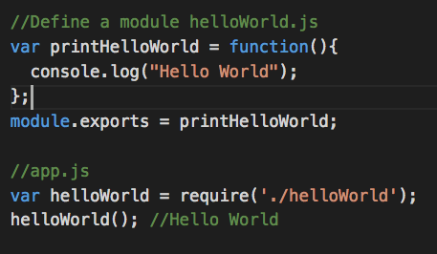
Types of JavaScript Modules
Common JS:

Slide 7
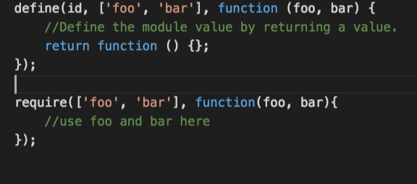
Asynchronous Module Definition(AMD):

Slide 8
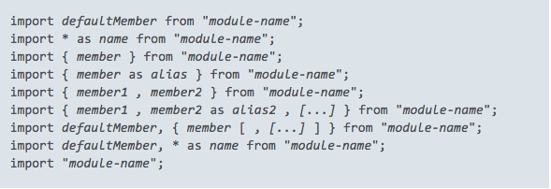
ES6 Modules: Imports
\

Slide 9
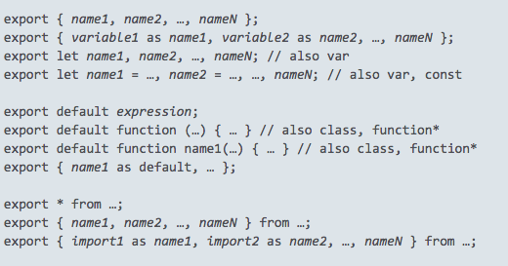
Exports:

Slide 10
Webpack

Slide 11
What is webpack ?
Advantages of webpack
Webpack setup and configuration
Pre Loaders, Loaders, Post Loaders
Plugins
Webpack modes
AMD and CJS modules examples
Webpack-dev-server
Source Map generation and minification
Transpiling ES6 code using babel
Handling CSS, LESS and images

Slide 12
Transpiling ES6 code using babel
Handling CSS, LESS and images
Writing a custom plugin

Slide 13
SystemJS and JSPM

Slide 14
Introduction to SystemJS
Automatic module detection
Loader Hooks
System JS Configuration
JSPM and advantages
JSPM Installation and Configuration
Single install and single require
JSPM Bundling

Slide 15
System JS
Universal Dynamic Module loader
Built around ES6 Module loader polyfill
Loads any module format
Supports Require JS style format – map, path, shims
Works well with Tracer and Babel

Slide 16
Loader Pipeline
Normalize
Locate
Fetch
Translate
Instantiate

Slide 17
JSPM – Java Script Package Manger
Friction less browser package management
Built around SystemJS dynamic ES6 loader
ES6 Standards compliant and future friendly
Supports any number of independent registries

Slide 18
Q & A

Slide 19
Thank You

